Slide 1

AimHigh Fitness Tracker
Om, Ryan, Hogan, Matt, Camden

Slide 2
Roles and Responsibilities
Om - Backend and Home page
Ryan - Progress page
Cam - Fitness Page
Hogan - Nutrition Page
Matt - Login page and Settings

Slide 3
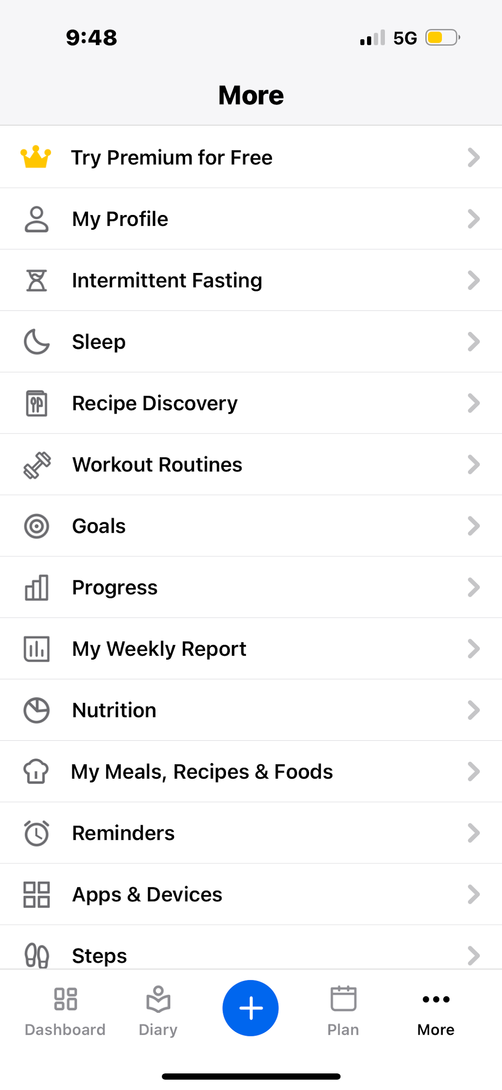
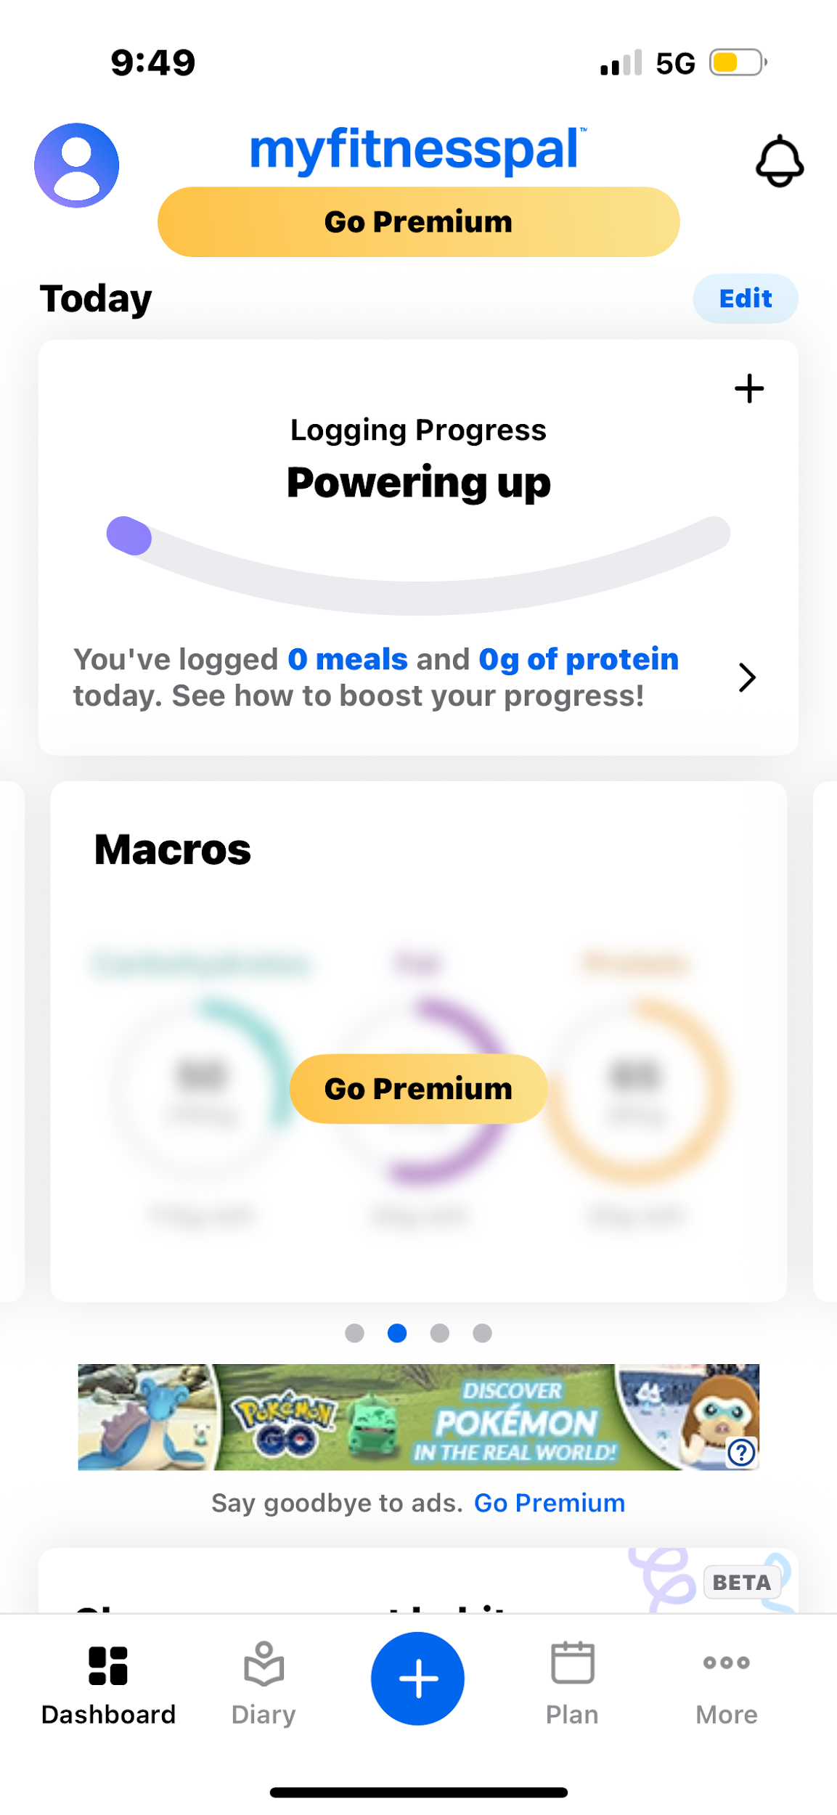
The Problem
Struggles with other fitness apps
Confusing UI
Paywalls
Doesn’t feel personal

Slide 4
App Overview
A fitness and wellness app designed to track all fitness needs.
Workouts, runs, and daily meals all in one place.
Dashboard shows real time progress, weekly trends, and daily activity summaries
Clean and modern UI with a consistent theme for quality user experience
Homepage
Login / Settings
Nutrition
Fitness
Progress
Backend
Notes:
A fitness and wellness app designed to track all your fitness needs
Workouts, runs, and daily meals all in one place
Dashboard showing real time progress, weekly trends, and daily activity summaries
Clean and modern UI with a consistent theme for quality user experience

Slide 5



Tools and Technologies Used
React Native: Cross platform UI development platform with reusable components for fast iteration and consistent design across iOS and Android
Expo Go: Streamline mobile development environment by allowing real-time testing, fast prototyping, and one click deployment without the hassle of building native apps
Firebase: Backend infrastructure providing authentication, real-time updates, and cloud database

Slide 6
App Startup and Home Page
With Firebase authentication, users can create an account where all their information is stored
The app will prompt the new user for health data and nutrition goals
Home Page:
Quick Buttons: Start run, Start workout and Track Nutrition
Weather Forecast
Nearby Runs

Slide 7
Login Page and Settings
Simple login page so users can save their data
Able to skip sign in and use app not signed in
Clean settings UI that allows you to edit aspects of your profile
Allows you to recalculate your macros if your goals change.

Slide 8
Nutrition Functionalities
Macro Tracking
Daily Tracking of calories and food macros
API Access
API Access to search or scan food items
Recipe search that gives information via web recipes or youtube videos
Macro Updating
Update your macros to fit your goals

Slide 9
Fitness Functionalities
Create and track workouts
Workouts get updated to progress tab

Slide 10
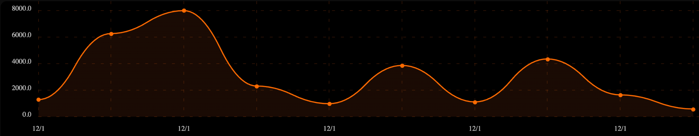
Progress Functionalities
Calendar
Formatted to help you stay organized and on track with fitness goals
Aids in planning future workouts
Will log all past workouts, meals, and runs for you
Overview
High level view of your total workouts, personal bests, average reps, and workout streak.
Trends
Will provide you with organized graphs of trends with your specific workouts.
Motivates you to keep improving
My Sit Up Volume
11/24
11/25
11/28
11/30

Slide 11

What We Learned
Database communication and real-time app updating
Pages and data talking to each other in the app
The pros and cons to AI assistance
AI could help a lot with ideas and solving problems
Could also mess everything up in the process
The benefit to early backend setup
Integrating the backend towards the end made updating and linking pages pretty difficult

Slide 12
Questions?
Thank you for listening

